Slide 1
UE18CS390A – Capstone Project Approval
Project Title : Analyzing evolution of terrorist group networks.
Project ID : 77
Project Guide : Prof. Sreenath MV
Project Team :
Name | SRN
Mahammad Thufail | PES2201800646
Manne Vasanth | PES2201800425
Purushotham S | PES2201800480
Pulle Manikya Sri Manasa | PES2201800468

Slide 2
Outline
Problem Statement
Scope and Feasibility study
Applications/Use cases
Expected Deliverables
Capstone (Phase-I & Phase-II) Project Timeline

Slide 3
Problem Statement
Elicit terrorist group networks from a database of terrorist events.
Terrorism is a type of collective violence having direct impact on peace, normal routine of a country/community and security and it is also a way to generate fear in civilians using violence.Terrorism is an evolving phenomenon, thus it is vital to provide counter-terrorism operators with tools for the prevention of it.

Slide 4
The main objective of this work is to define an approach aiming at eliciting knowledge on terrorist attack perpetrators by analyzing terror events along the timeline. The idea is to construct a sociogram, i.e., a network of perpetrators, where the nodes represent terrorist groups and the edges represent generic relations occurring between two groups.
Lastly, considering terrorist group networks along the timeline allows to study the temporal evolution of relations between such groups. With respect to the adopted data source, the aforementioned conceptualization is realized by considering the historical data provided by the Global Terrorism Database (GTD).

Slide 5
About Dataset
GTD is an open source database that includes terrorist activities or events information all around the world since 1970. This dataset considers 9 main attributes and many sub attributes, those 9 attributes are:
ID and date,
Incident information,
Incident location,
Attack information,
Weapon information,
Target/victim information,
Perpetrator information,
Casualties and consequences,
Additional information and sources.

Slide 6
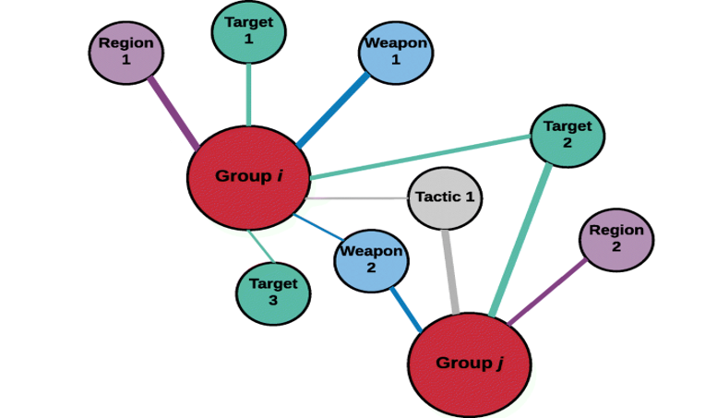
Implementation
Since the variables of the modes of Targets, Weapons, Tactics, and Regions form a many-to-many relationship with the terrorist groups, we first model this data with each partition joined to the terrorist groups.

Slide 7
Scope and Feasibility study
Our project contributes to this development by providing comprehensive collection of terrorist events including both domestic and international incidents. While these data have some well-known limitations, they also provide a wide variety of analysis opportunities.
Improve their quality and to expand the types of analysis being conducted with the data. As event databases improve, new avenues for validating them become feasible. An important method for assessing the quality of event databases on terrorism will be to do systematic comparisons between different sources of event data and between terrorism data drawn from other sources

Slide 8
Using internet as platform to analyze terrorist group networks : Online discussions provide an opportunity to present opposing viewpoints or to engage in constructive debate, which may have the effect of discouraging potential supporters. Successful messages may also demonstrate empathy with the underlying issues that contribute to radicalization, such as political and social conditions, and highlight alternatives to violent means of achieving the desired outcomes.
We use igraph and NetworkX to analyze networks and find similarities between different groups. Since these softwares are open source its feasible to proceed

Slide 9
Applications
To provide a theoretical framework for understanding terrorist networks. We believe that SNA application to terrorism is likely to be of utility to strategic analysts and information scientists; and, possibly, to agencies dealing with national security.
Similarly , we can find the most influential person with maximum number of relations between other networks and try to prevent the attacks.
By analyzing terrorist connections we can reduce the number of illegal activities.

Slide 10
Expected Deliverables
Capstone-I deliverables
Understanding Problem statement, Literature review, Data Preprocessing, Understanding Algorithm and High Level Designing
Capstone-II deliverables
Implementation of the approach using similarity function based on rough set theory analyzing the temporal evolution of the network .

Slide 11
Capstone (Phase-I & Phase-II) Project Timeline

Slide 12






 | FEBRUARY |  |  |  | MARCH |  |  |  | APRIL
 | Week 1 | Week2 | Week3 | Week 4 | Week1 | Week2 | Week3 | Week4 | Week1 | Week2 | Week3 | Week4
Understanding Problem statement
Literature review
Data Preprocessing
Understanding Algorithm
High Level Design
Conclusion of Phase 1 And Future work of Phase 2
Problem
Literature
Data
Algorithm
Design
Conclusion

Slide 13
Thank You

